Slide 1
Project Proposal​
Data Analysis 2023
Sub-project 2: HeLa_Mitosis = HeLa cells synchonized in mitosis​
Jimena Orrego Chong; Alexandra Kornelius ; Verena Lise Kantelhardt;
Notes:
We aim to analyze mass spectrometry data to be able to automatically identify RBPs and other RNA dependent proteins

Slide 2
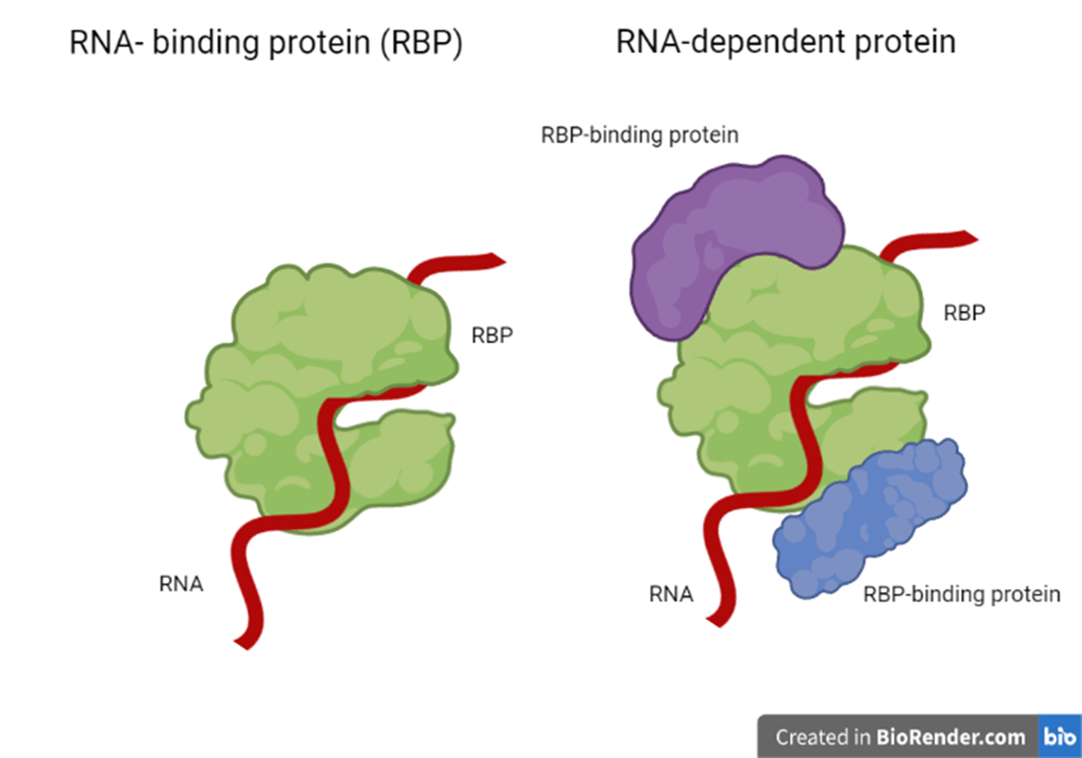
What are RNA-binding proteins?
Adaptation of RBP concept
RNA-dependence when interactome depends on RNA, without necessarily binding to RNA
RNA- dependence
Adapted from Caudron-Herger et al. (2019). R-DeeP: Proteome-wide and Quantitative Identification of RNA-Dependent Proteins by Density Gradient Ultracentrifugation. Molecular Cell 75
Notes:
RNA-binding proteins, or RBPs, are proteins capable of binding double- or single-stranded RNA in cells while forming a ribonucleoprotein (RNP) complex.
In this project we work with the concept extension of RNA-dependence made by Caudron-Herger et al. This defines RNA-dependence when an interactome depends on RNA, even if it does not bind to RNA itself (eg Abb RBPP binding protein)
RBp binding proteins = RBP interacting proteins

Slide 3
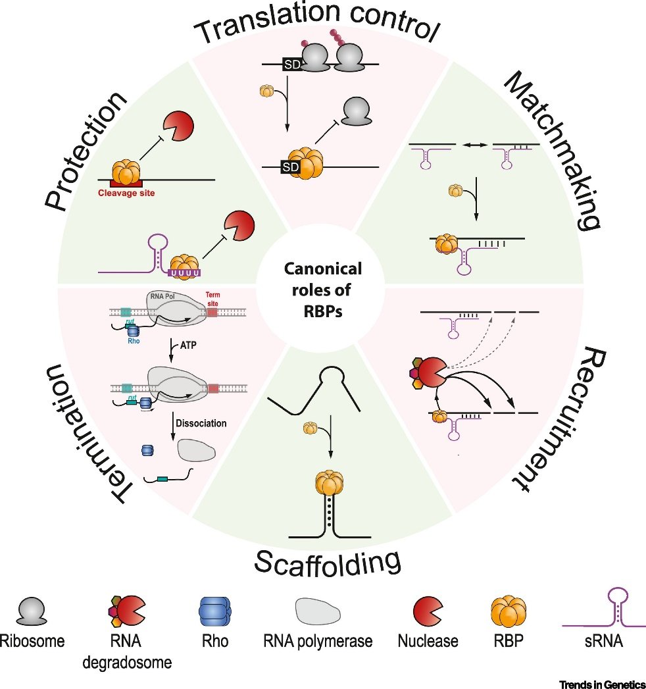
Why are RBPs important?
RBPs malfunctions:
Multiple Sclerosis (MS)
Embryological development problems
Cancer
Ng Kwan Lim, E., Sasseville, C., Carrier, M.-C., and Massé, E. (2021). Keeping Up with RNA-Based Regulation in Bacteria: New Roles for RNA Binding Proteins. Trends in Genetics 37, 86-97.
Notes:
RBPs fulfill different roles in different cellular processes.
They regulate the protection of RNA, as the presence of an RBP on an RNA molecule (eg sRNA/mRNA) prevents transcription degradation. RBPs regulate RNA transcription, because a bind of mRNA may inhibit translational initiation through steric hindrance. They also play a role in the control of matchmaking, recruitment, scaffolding and termination.
RBPs malfunction have also been linked to neurodegenerative diseases like multiple sclerosis, problems in embryological development and cancer.
In cancer, aberrantly expressed RBPs regulate expression levels of target RNAs associated with proliferation, apoptosis, angiogenesis, senescence, and metastasis of cancer cells. Meaning, RBP-mediated regulation contributes to cancer development and pathology

Slide 4

Why are RBPs important?
proteome-wide, specific, and quantitative analysis of RNA-dependent proteins
based on density gradient ultracentrifugation
Ng Kwan Lim, E., Sasseville, C., Carrier, M.-C., and Massé, E. (2021). Keeping Up with RNA-Based Regulation in Bacteria: New Roles for RNA Binding Proteins. Trends in Genetics 37, 86-97.
Notes:
As previously mentioned, we aim to identify RNA dependent protens and not only RBPs, so we follow the concept of the databank RDeeP. RDeeP converts the idea of RNA-dependent proteins into a proteome wide, unbiased, and enrichment-free screen, based on density gradient ultracentrifugation. Quantitative mass spectrometry of this databank identified 1,784 RNA-dependent proteins, including 537 lacking known links to RNA. Exploiting the quantitative nature of R-DeeP, proteins were classified as not, partially, or completely RNA dependent.

Slide 5
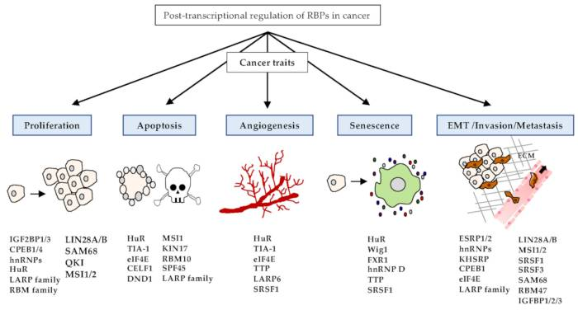
Diseases linked to RBPs malfunctions
Embryonic development
Multiple sclerosis
Cancer
Kang, D., Lee, Y., and Lee, J.S. (2020). RNA-Binding Proteins in Cancer: Functional and Therapeutic Perspectives. Cancers (Basel) 12.

Slide 6
R-Deep concept
proteome-wide, specific, and quantitative analysis of RNA-dependent proteins based on density gradient ultracentrifugation
Classification of proteins as:
Not RNA dependent
Partially RNA dependent
Completely RNA dependent
Analysis of specific protein fractions which are RNA dependent
Notes:
Database for RNA-dependent proteins
- discovery of unexpected RNA functions by newly linking 537 proteins to RNA and enabling quantification of the RNA dependent fraction of a protein.
Definition: RNA dependent when its interactome depends on RNA without necessarily directly binding to RNA
R-DeeP yields quantitative data establishing for each protein not only the RNA dependence but, in addition, the fraction of the protein that is RNA dependent
enables the distinction of proteins only partially interacting with RNA from proteins completely interacting with RNA, revealing new aspects and dimensions of the RNA-related function of RBP
In addition, it quantifies the fraction of each protein depending on RNA.
For each protein, the database displays information about peaks and shifts, a graphical view of the protein profiles in the gradients, specific information about the protein

Slide 7
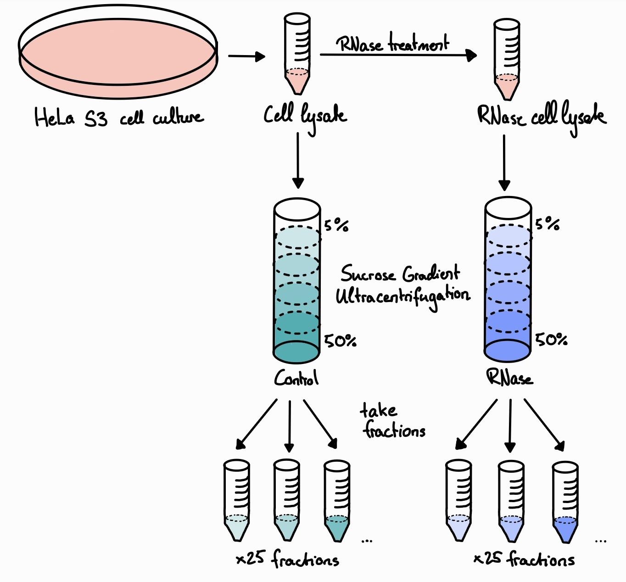
Experiment
RNA-dependent proteins migrate to different positions in a sucrose density gradient in the presence/absence of RNA
Adapted from Caudron-Herger et al. (2019). R-DeeP: Proteome-wide and Quantitative Identification of RNA-Dependent Proteins by Density Gradient Ultracentrifugation. Molecular Cell 75
Notes:
How was this data acquired?
First 2 samples of HeLa S3 cells in mitosis were taken; 1 sample being just a cell lysate, while the second a lysate with RNase treatment. Each lysate was then loaded into sucrose density gradients (5%-50%).
There we observed that RNA-dependent proteins migrate to different positions in a sucrose density gradient in the presence or absence of RNA, due to density differences.
Each gradient was then separated into 25 fractions, because each protein showed a specific distribution throughout the gradient.
RNA-dependent proteins migrate to different positions in a sucrose density gradient in the presence or absence of RNA
Analysed HeLa cells synchronized in mitoses, then cell lysing
we loaded HeLa cell lysate on a 5% to 50% sucrose density gradient and fractionated it into 25 fractions after ultracentrifugation
HeLa S3 cells are the third clone isolated and propagated from the original HeLa culture (ATCC CCL-2)

Slide 8
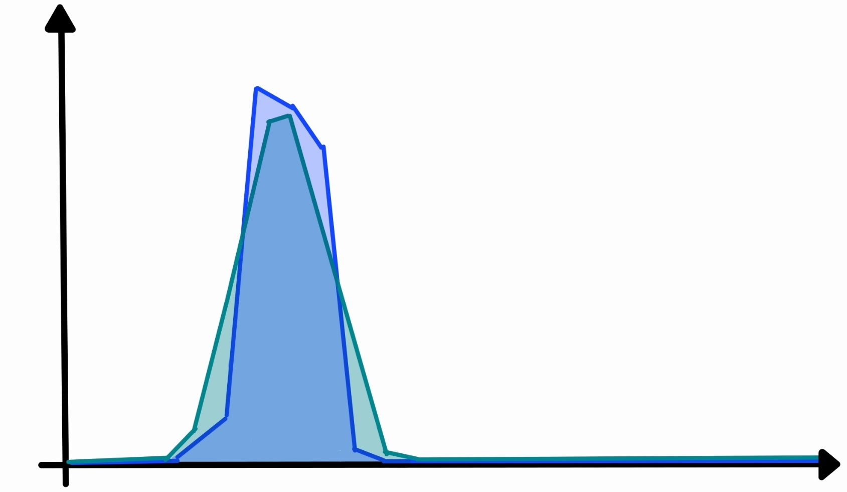
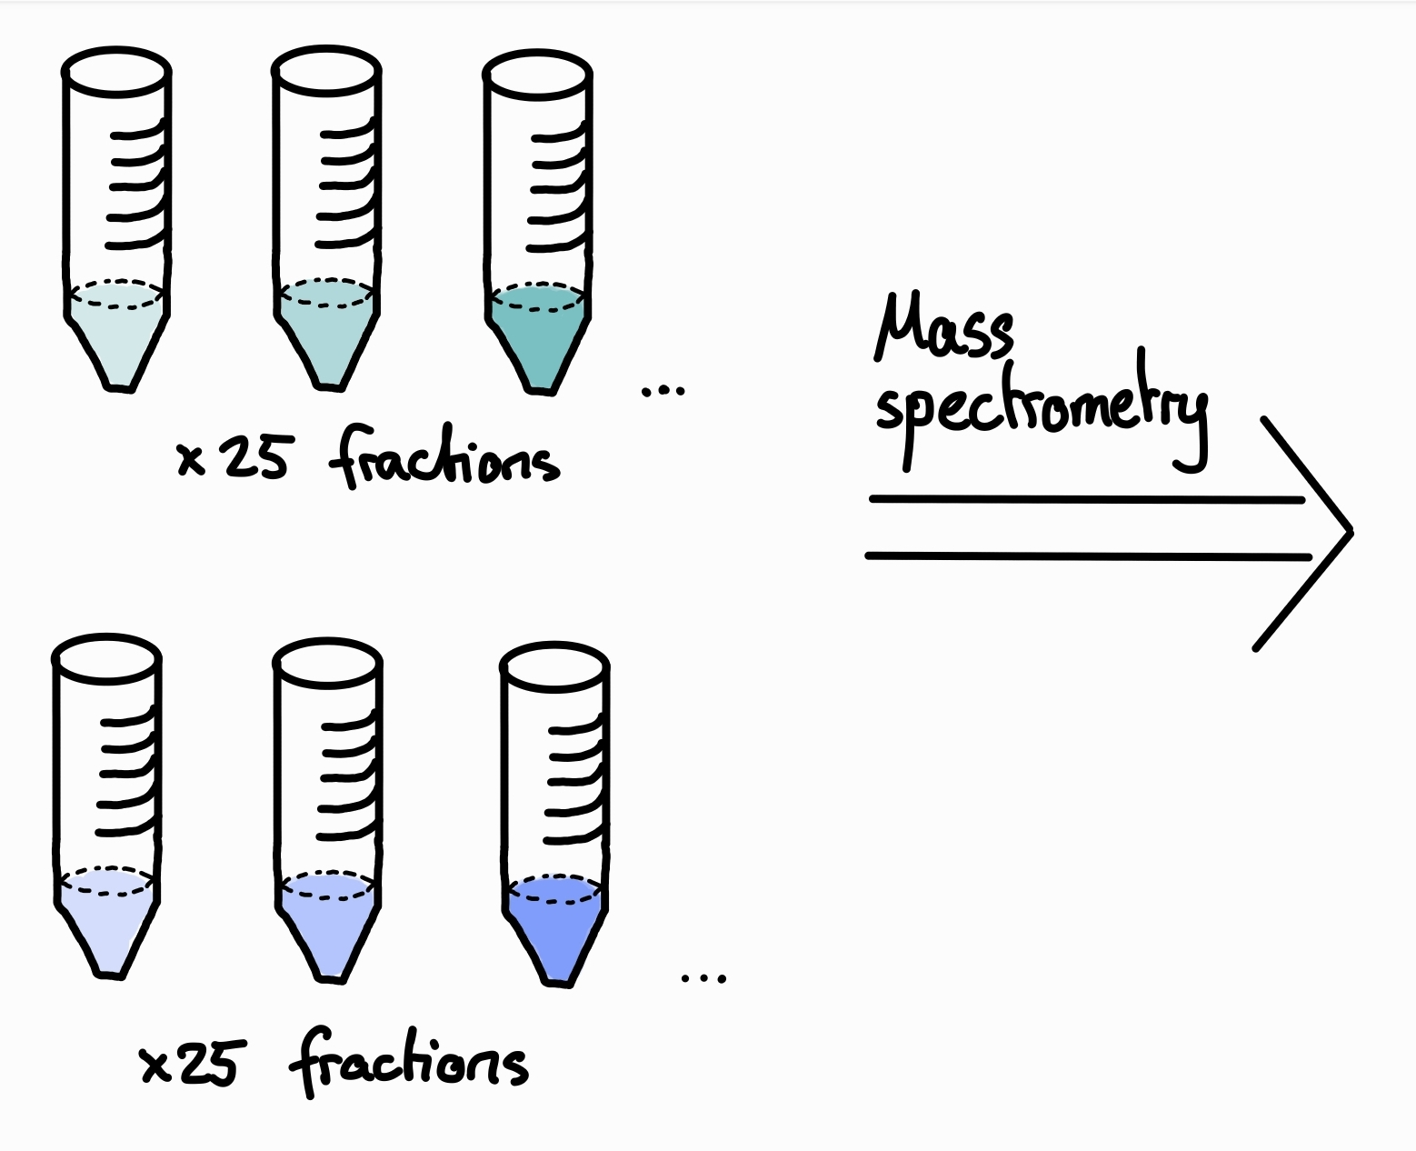
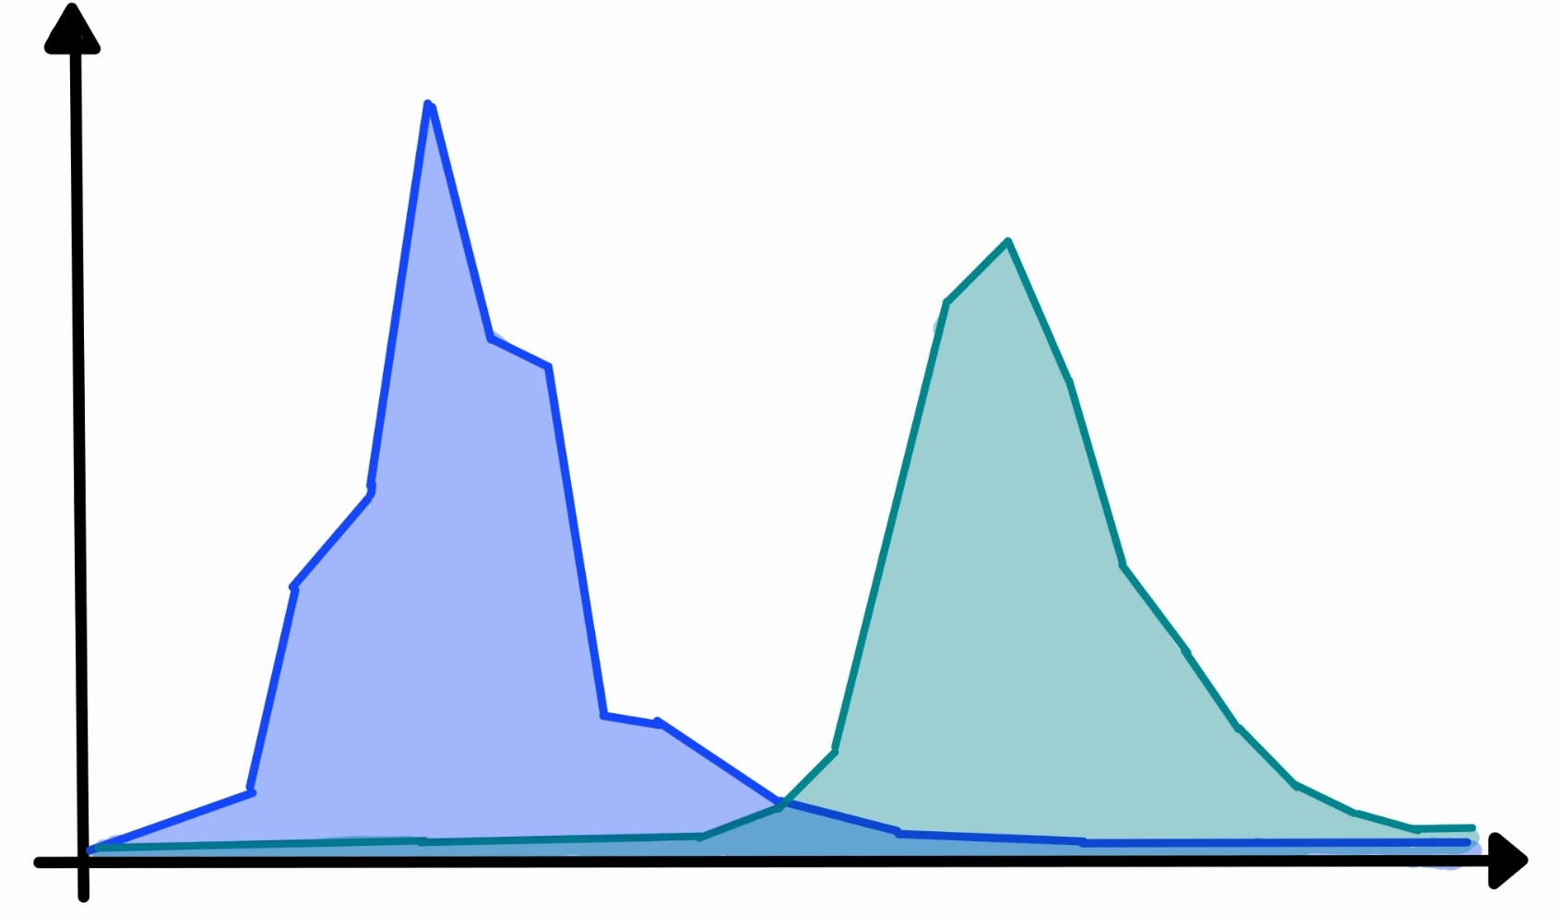
Control
RNase
Protein amount
Fractions
Control
RNase
Protein amount
Fractions
Adapted from Caudron-Herger et al. (2019). R-DeeP: Proteome-wide and Quantitative Identification of RNA-Dependent Proteins by Density Gradient Ultracentrifugation. Molecular Cell 75
Notes:
This fractions were finally analyzed by mass spectrometry, after which we could obtain graphs showing the protein amount in each fraction, whether with overlapping or shiftingfractions.
The protein content of each fraction was analyzed by mass spectrometry. Each protein showed a specific distribution throughout the gradient.
A shift between fractions of the control and the RNase-treated gradient revealed the RNA dependence of the protein

Slide 9
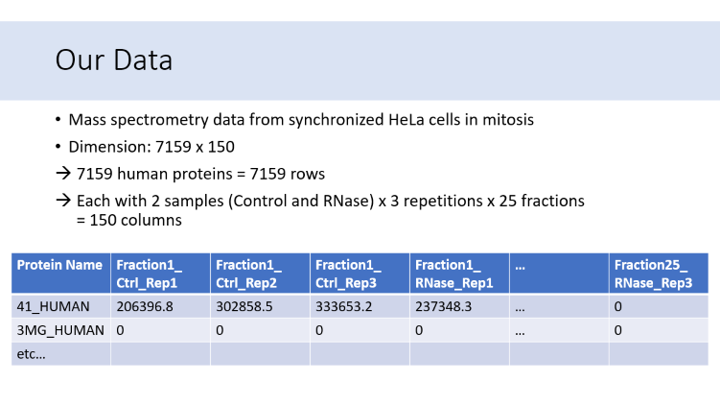
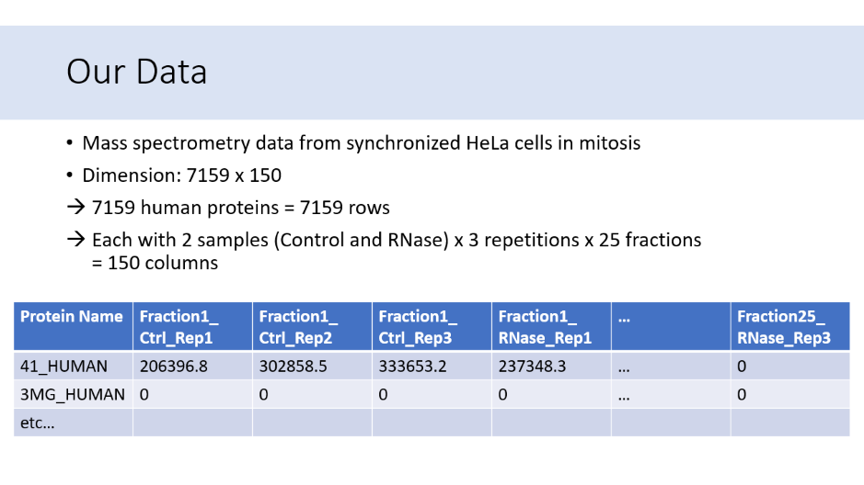
Planned Steps
Part 1: Data exploration & Data clean-up & Data reduction​
Description of DataSet: identify rows/columns → create an overview​

Slide 10
Our Data
Mass spectrometry data from synchronized HeLa cells in mitosis
Dimension: 7159 x 150
7159 human proteins = 7159 rows
Each with 2 samples (Control and RNase) x 3 repetitions x 25 fractions = 150 columns
Protein Name | Fraction1_ Ctrl_Rep1 | Fraction1_ Ctrl_Rep2 | Fraction1_ Ctrl_Rep3 | Fraction1_ RNase_Rep1 | … | Fraction25_ RNase_Rep3
41_HUMAN | 206396.8 | 302858.5 | 333653.2 | 237348.3 | … | 0
3MG_HUMAN | 0 | 0 | 0 | 0 | … | 0
etc…
Notes:
RNA interaction may depend on different cell-cycle stage: RNPs are dynamic entities changing composition through assembly and disassembly within short periods of time, for example if a specific protein is especially needed to induce higher RNA translation in mitosis, it might show RNA dependence during this stage, but not in others. This allows characterization of the protein dynamics in the cell cycle
Already found one row with only 0’s → possibly error in experiment or data digestion

Slide 11
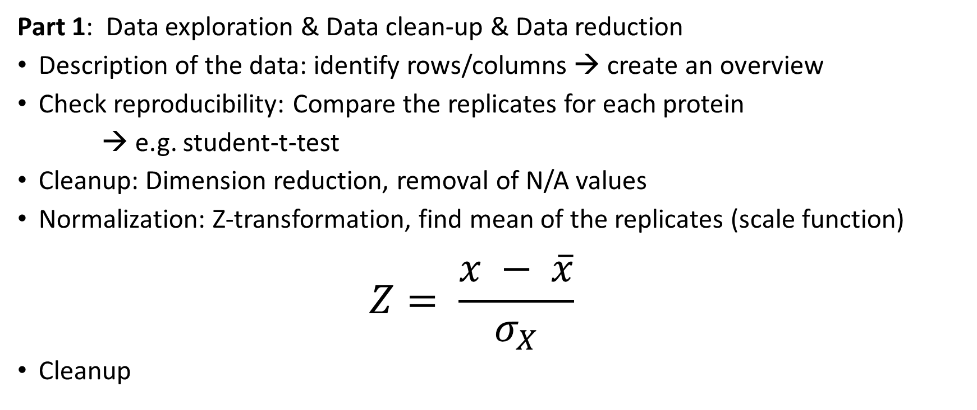
Planned Steps
Part 1: Data exploration & Data clean-up & Data reduction ​
Description of the data: identify rows/columns → create an overview​
Check reproducibility: Compare the replicates for each protein
→ e.g. student-t-test
Cleanup: Dimension reduction, removal of N/A values
Normalization: Z-transformation, find mean of the replicates (scale function)
$$Z= \frac{x − \overline{x}}{σ_{X}}$$
Cleanup
Notes:
Proteins -> rows; Fractions -> cloumns; possible seperate into table for RNase and Control
Check reproducitiy by checking if there is a significant difference between to replicates in one protein; significance-test; choose alpha: either 0,01 or 0,05; f.e. student-t-test
if they are significantly different the results are less reproducible
Get rid of rows with data that is significantly different. Bc we want to use z-transformation -> need 3 numbers for each protein; never just delete one column of one protein, alway delete the entire protein. Delete rows of 0. -> standard normal distribution
Wenn wir die replicates unter dem mean zusammenfassen können wir danach keine falsch-positiv/falsch-negativ Rate mehr berechnen?!

Slide 12
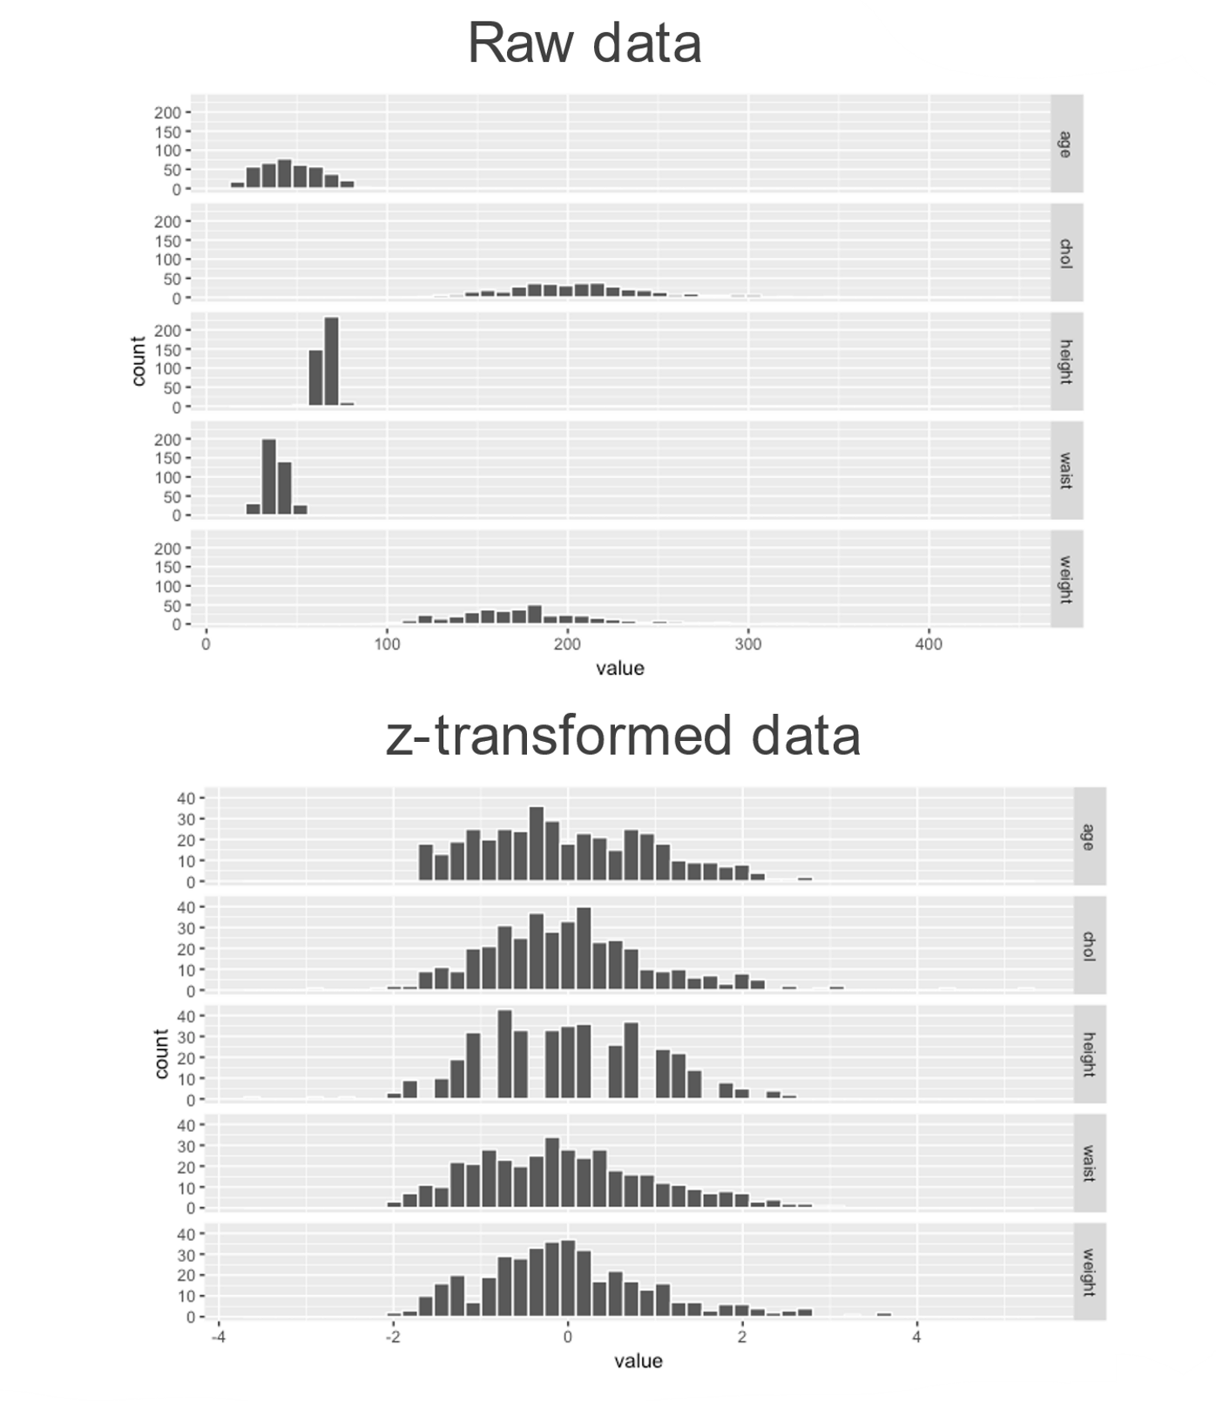
From Carl Hermann bioinformatic lectures
Notes:
Mean = 0 for z transformed data; standard deviation = 1

Slide 13
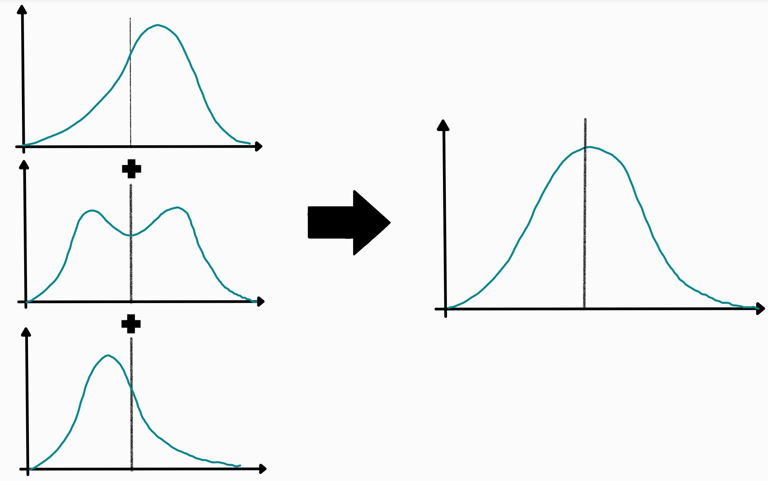
Notes:
Ich glaube die hier ist dann nicht ganz richtig, weil es hier so aussieht als würde der Mittelwert schwanken, was er nach der z-transformation ja nichtmehr würde

Slide 14
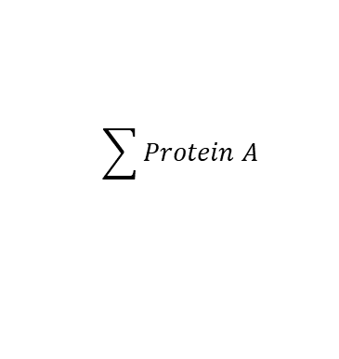
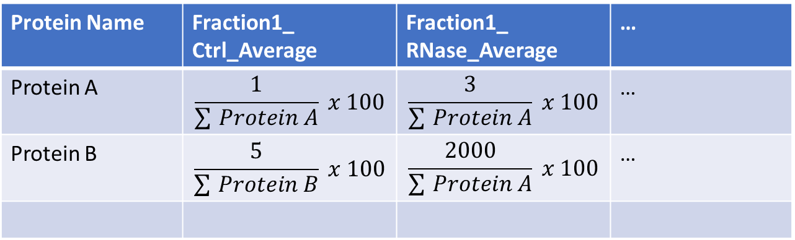
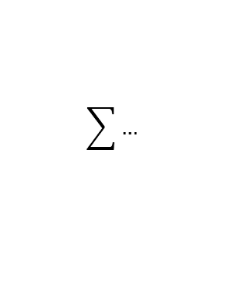
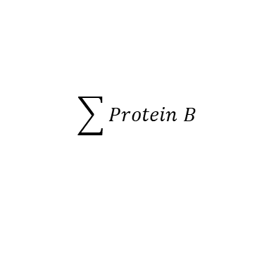
Data scaling
Protein Name | Fraction1_ Ctrl_Average | Fraction1_ RNase_Average | …
Protein A | 1 | 3 | …
Protein B | 5 | 2000 | …
$$\sum_{ }^{ }{Protein A}$$
$$\sum_{ }^{ }{Protein B}$$
$$\sum_{ }^{ }{…}$$
Protein Name | Fraction1_ Ctrl_Average | Fraction1_ RNase_Average | …
Protein A | $$\frac{1}{\sum_{ }{Protein A}} x 100$$ | $$\frac{3}{\sum_{ }{Protein A}} x 100$$ | …
Protein B | $$\frac{5}{\sum_{ }{Protein B}} x 100$$ | $$\frac{2000}{\sum_{ }{Protein A}} x 100$$ | …
Notes:
transforming your data so that it fits within a specific scale, like 0-100

Slide 15
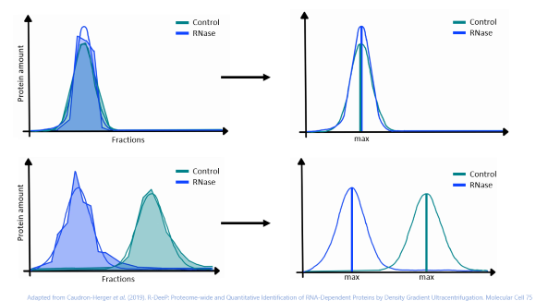
Planned Steps
Part 2: Data modelling​
Plot gaussian graph
Identify maxima in gaussian graph​
Get overview
Notes:
Sort each protein into a variable/vector. Plot the data; one gaussian grah per protein. Add a mean line. Maxima is where in the fractions there is the highest concentrations in the fractions
Because we now have a lot of plots, we´ll take time to get an overview. Possibly delete confusing graphs (with more than one/two local maxima)

Slide 16
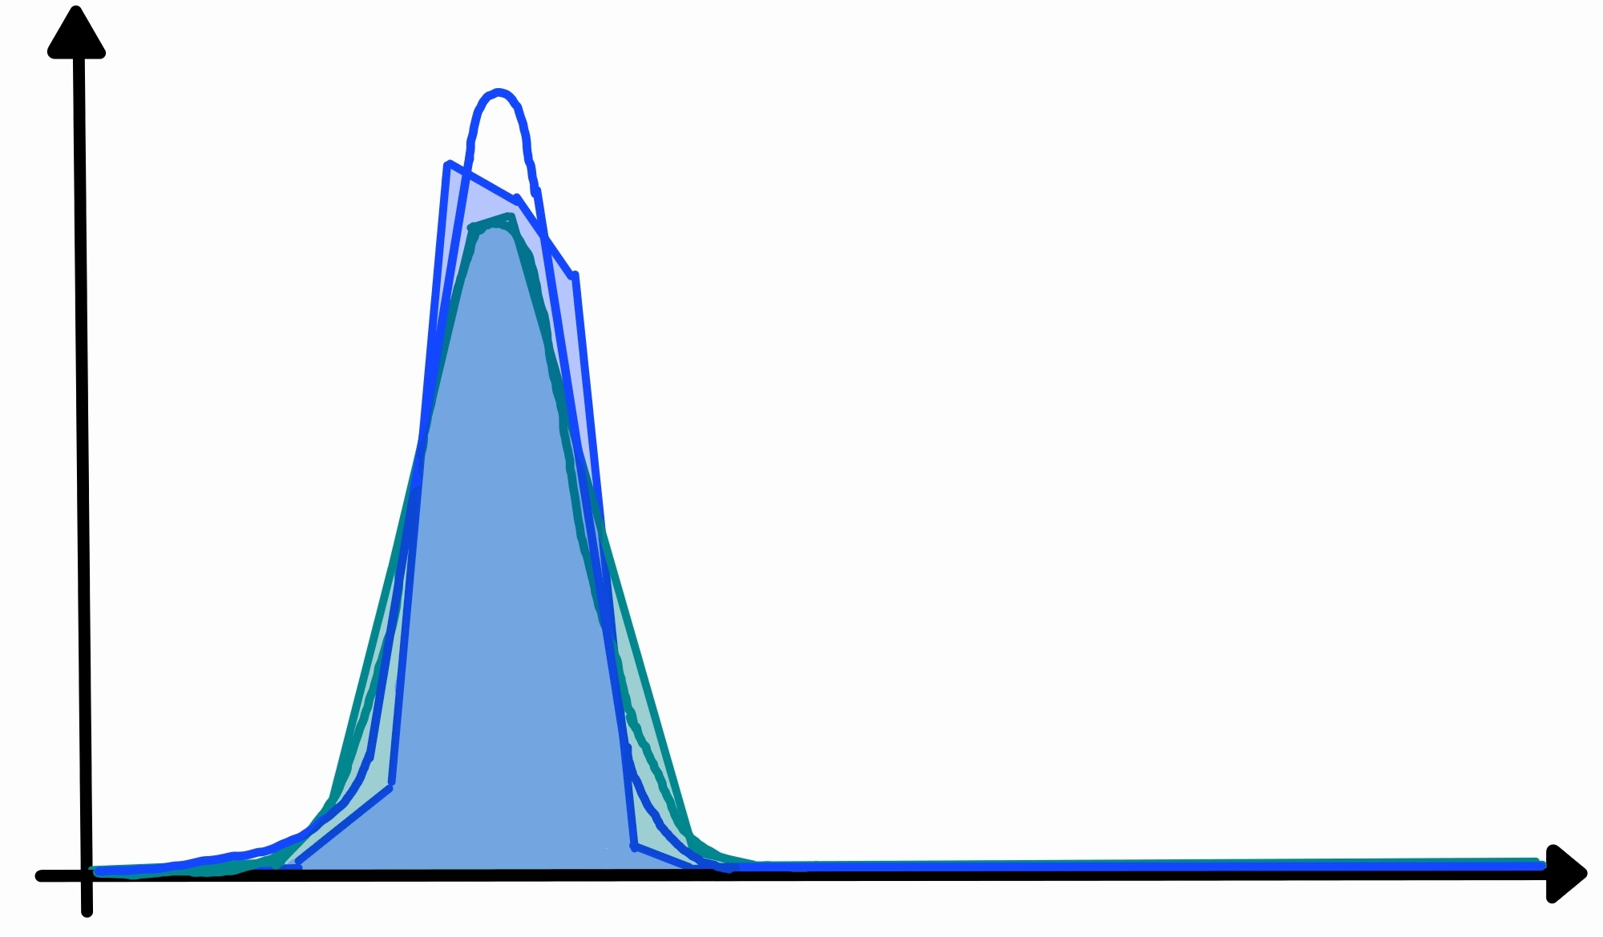
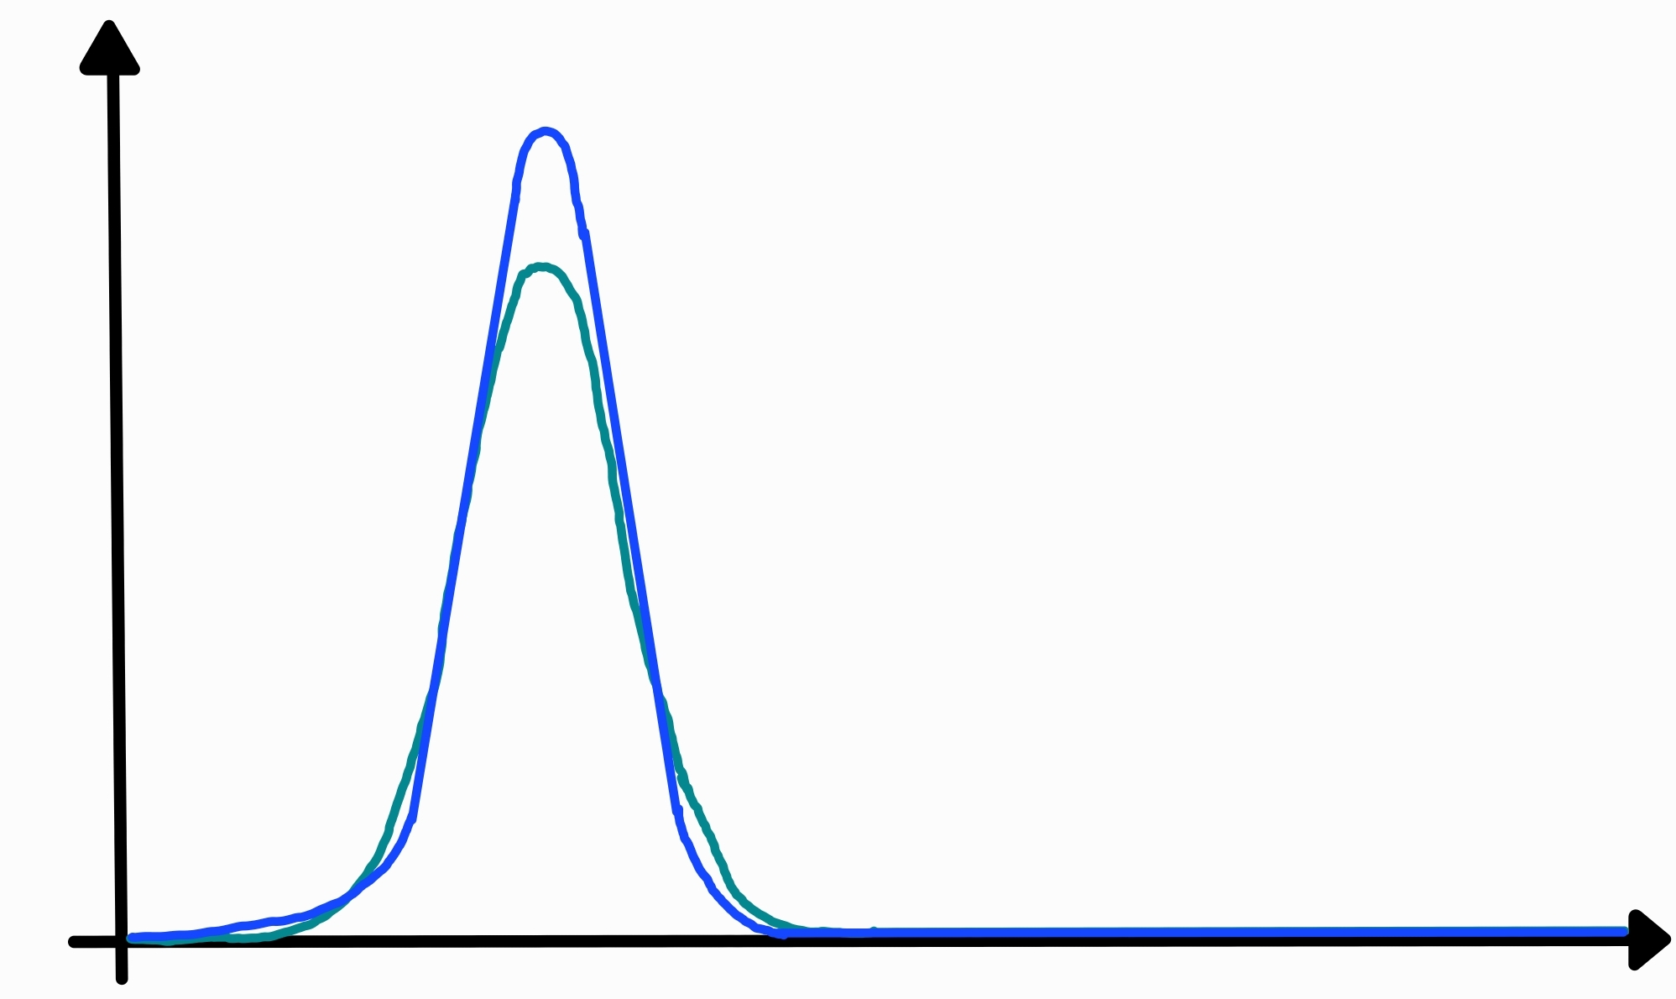

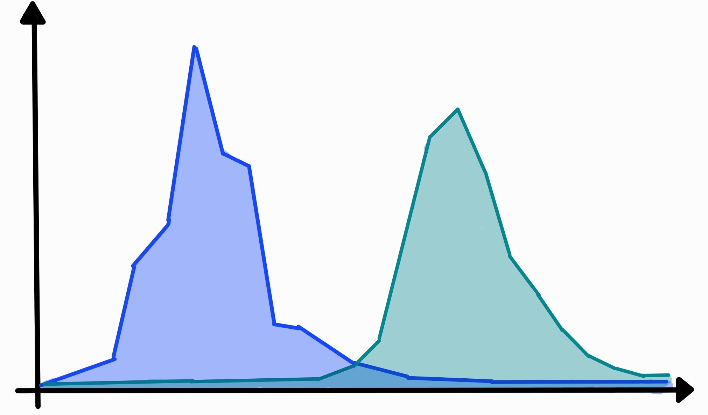
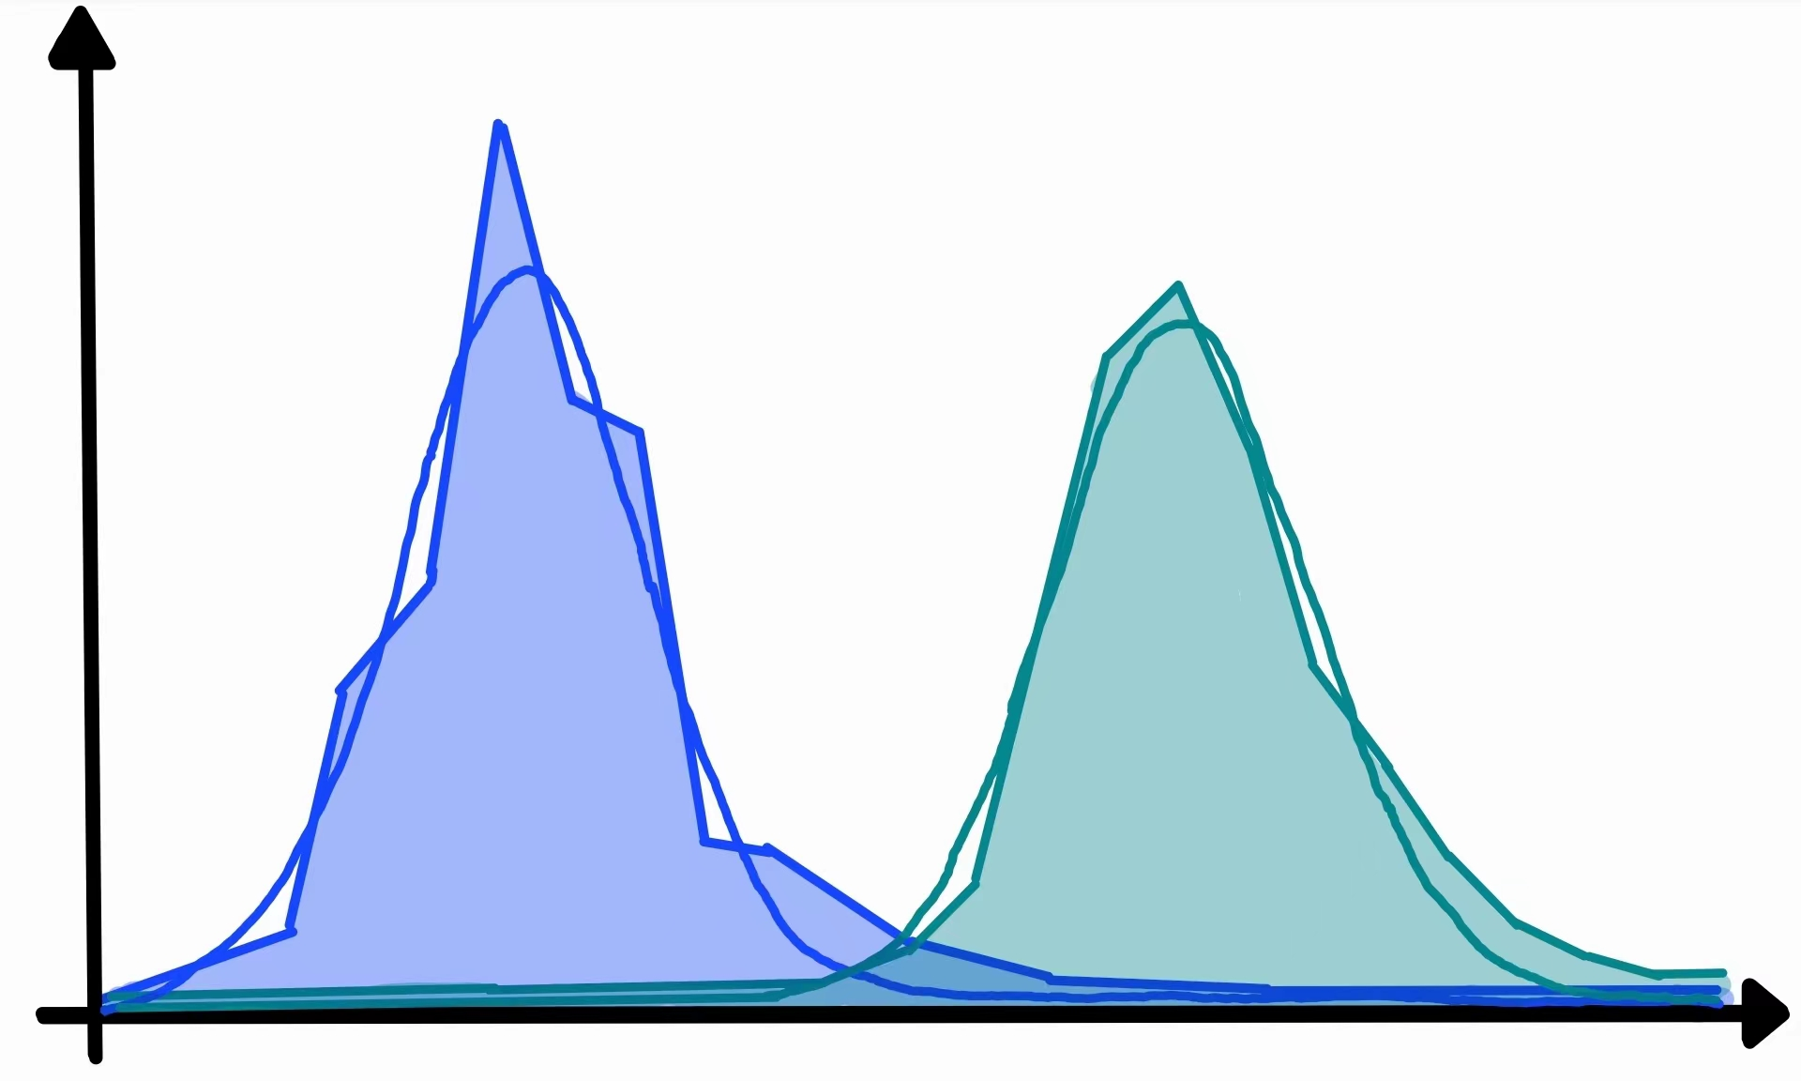
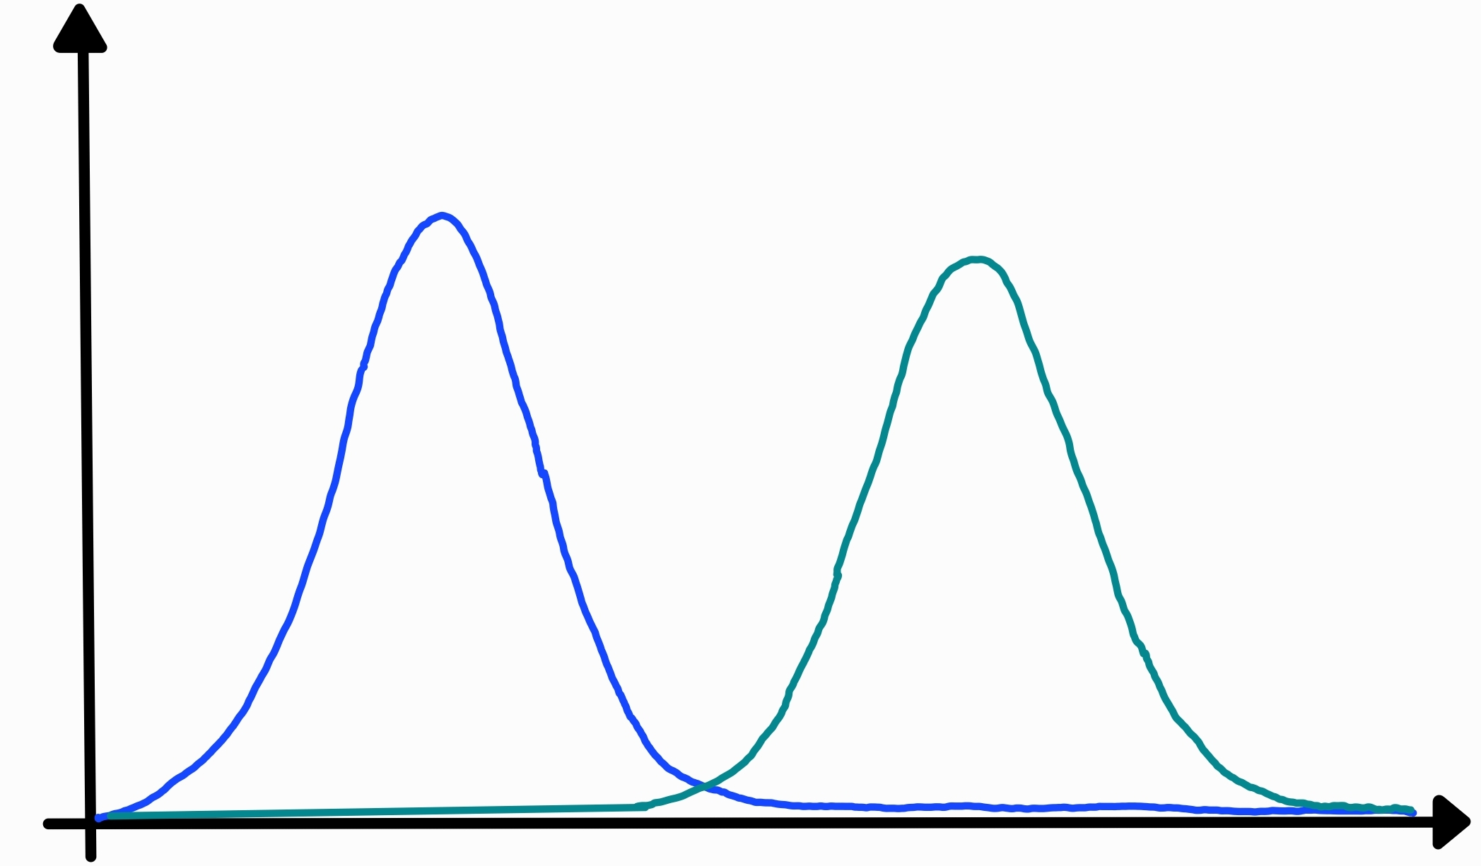
Control
RNase
Control
RNase
Protein amount
Fractions
max
Control
RNase
Control
RNase
Protein amount
Fractions
max
max
Adapted from Caudron-Herger et al. (2019). R-DeeP: Proteome-wide and Quantitative Identification of RNA-Dependent Proteins by Density Gradient Ultracentrifugation. Molecular Cell 75

Slide 17
Control
RNase
Control
RNase
Protein amount
Fractions
max
Control
RNase
Control
RNase
Protein amount
Fractions
max
max
Adapted from Caudron-Herger et al. (2019). R-DeeP: Proteome-wide and Quantitative Identification of RNA-Dependent Proteins by Density Gradient Ultracentrifugation. Molecular Cell 75

Slide 18
Timetable
Tasks | May
 | 1 | 2 | 3 | 4 | 5 | 6 | 7 | 8 | 9 | 10 | 11 | 12 | 13 | 14 | 15 | 16 | 17 | 18 | 19 | 20 | 21 | 22 | 23 | 24 | 25 | 26 | 27 | 28 | 29 | 30
Project Proposal
Part 1
Part 2
Tasks | June
 | 1 | 2 | 3 | 4 | 5 | 6 | 7 | 8 | 9 | 10 | 11 | 12 | 13 | 14 | 15 | 16 | 17 | 18 | 19 | 20 | 21 | 22 | 23 | 24 | 25 | 26 | 27 | 28 | 29 | 30 | 31
Part 2
Buffer
Part 3
Part 4

Slide 19
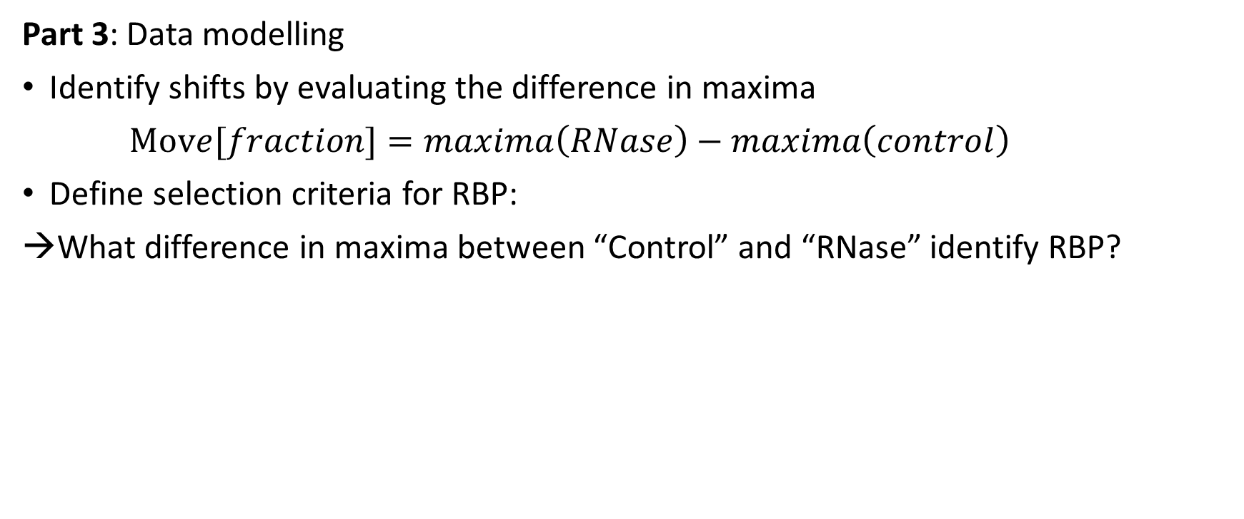
Planned Steps
Part 3: Data modelling​
Identify shifts by evaluating the difference in maxima
$Move[fraction]=maxima\left(RNase\right)−maxima\left(control\right)$
Define selection criteria for RBP:
What difference in maxima between “Control” and “RNase” identify RBP​?
Notes:
judge the previously figured maxima. Figure a numeric value for the difference​
Figure out a unit in which we can measure the shift. F.e. delta fractions; shift between maxima?
Define a shift that will be used to define RBP. What is a good value?! -> possibly figuring out a window in which that value has to be by comparing shifts of RBP with no-RBP
→ E.g. Shift of 1 fraction or more
Spezifische Grenzwerte ansehen: RBP die nur knapp als RBP oder non-RBP bestimmt wurden von uns. In Datenbanken diese Proteine prüfen
Zweiten Grenzwert festlegen über Vergleich mit zweitem Grenzwert

Slide 20
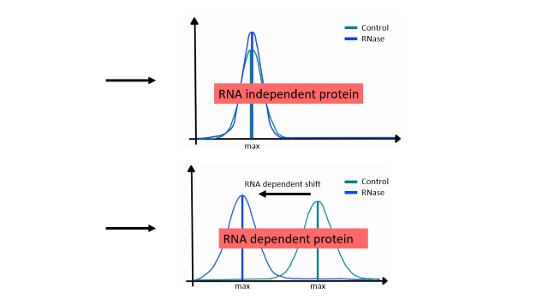
Planned Steps
Part 4: Finalizing data​
Apply selection criteria
Notes:
Now that we have found our selection criteria we can move on to part 4.
Apply the criteria -> identify RBP, and then possibly adapt different criteria and compare them in their accuracy.
Visualize our results
Clustering-> identify groups by distinguishing between left/right/no shift (according to how strong the shift was); possibly identifying RBP-binding proteins as well as direct RBPs
Try out k means clustering for assigning each protein into clusters with regard to their shift characteristics
Alternatively try out clustering using protein content quotients, this might help differentiate between RNA dependent proteins but is still in discussion
4. Use linear regression to identify RBPs -> predict which proteins will have a dependance. We could use our data to train a model which can predict the x-shift, for examlpe using the protein quotients or the maxima etc. (this will possibly simplify the classification but is likely to be less accurate.)

Slide 21
Control
RNase
RNA independent protein
max
RNA dependent shift
Control
RNase
RNA dependent protein
max
max
Notes:
Back to the graphic we showed before, we can see an maxima shift in the second graph and by applying the selection criteria we can identify the protein as RNA dependent. We sort the proteins into categories according to their shifts.
Alternative method would be to not only look at the maxima peak, but at the area under the curves and use protein quotients. According to our results we will possibly test other selection criteria and compare them in their accuracy using known RBPs from public databases.

Slide 22
Planned Steps
Part 4: Finalizing data​
Apply selection criteria
Visualization: Produce graphics for specific proteins ​
Clustering → identify groups, e.g. right/left/no shift, etc.
Perform linear regression
Notes:
Now that we have found our selection criteria we can move on to part 4.
Apply the criteria -> identify RBP, and then possibly adapt different criteria and compare them in their accuracy.
Visualize our results
Clustering-> identify groups by distinguishing between left/right/no shift (according to how strong the shift was); possibly identifying RBP-binding proteins as well as direct RBPs
Try out k means clustering for assigning each protein into clusters with regard to their shift characteristics
Alternatively try out clustering using protein content quotients, this might help differentiate between RNA dependent proteins but is still in discussion
4. Use linear regression to identify RBPs -> predict which proteins will have a dependance. We could use our data to train a model which can predict the x-shift, for examlpe using the protein quotients or the maxima etc. (this will possibly simplify the classification but is likely to be less accurate.)

Slide 23

Timetable
Tasks | May
 | 1 | 2 | 3 | 4 | 5 | 6 | 7 | 8 | 9 | 10 | 11 | 12 | 13 | 14 | 15 | 16 | 17 | 18 | 19 | 20 | 21 | 22 | 23 | 24 | 25 | 26 | 27 | 28 | 29 | 30
Project Proposal
Part 1
Part 2
Tasks | June
 | 1 | 2 | 3 | 4 | 5 | 6 | 7 | 8 | 9 | 10 | 11 | 12 | 13 | 14 | 15 | 16 | 17 | 18 | 19 | 20 | 21 | 22 | 23 | 24 | 25 | 26 | 27 | 28 | 29 | 30 | 31
Part 2
Buffer
Part 3
Part 4
Tasks | July
 | 1 | 2 | 3 | 4 | 5 | 6 | 7 | 8 | 9 | 10 | 11 | 12 | 13 | 14 | 15 | 16 | 17 | 18 | 19 | 20 | 21 | 22 | 23 | 24 | 25 | 26 | 27 | 28 | 29 | 30
Part 4
Part 5
Notes:
We have planned over two weeks to finalize our selection criteria and produce presentable graphics. It is important for us that this is finished at least one week before the Github deadline. Because in this last week we will do our final sprint

Slide 24

Planned Steps
Part 5: final sprint​
Sort out GitHub​
Write ReadMe​
Write Report​
Prepare final presentation​
Notes:
Final sprint is composed of…

Slide 25
Timetable
Tasks | May
 | 1 | 2 | 3 | 4 | 5 | 6 | 7 | 8 | 9 | 10 | 11 | 12 | 13 | 14 | 15 | 16 | 17 | 18 | 19 | 20 | 21 | 22 | 23 | 24 | 25 | 26 | 27 | 28 | 29 | 30
Project Proposal
Part 1
Part 2
Tasks | June
 | 1 | 2 | 3 | 4 | 5 | 6 | 7 | 8 | 9 | 10 | 11 | 12 | 13 | 14 | 15 | 16 | 17 | 18 | 19 | 20 | 21 | 22 | 23 | 24 | 25 | 26 | 27 | 28 | 29 | 30 | 31
Part 2
Buffer
Part 3
Part 4
Tasks | July
 | 1 | 2 | 3 | 4 | 5 | 6 | 7 | 8 | 9 | 10 | 11 | 12 | 13 | 14 | 15 | 16 | 17 | 18 | 19 | 20 | 21 | 22 | 23 | 24 | 25 | 26 | 27 | 28 | 29 | 30
Part 4
Part 5

Slide 26
Goals
Part 1
Have a cleaned dataset
Have gaussian graphs with maxima
Part 3
Calculated the shift of maxima
Part 2
Part 4
Part 5
Identified RBPs
Finalized GitHub
Determined selection criteria
Clustered proteins
Used linear regression
Hand in final report
Hand in final presentation
Checked for reproducibility
Notes:
Part 5: sum everything up and make it presentable.

Slide 27

Outlook
Comparison of our data with other public databases
How can we explain differences in classification?
R-Deep aids in the reconstruction of protein complexes
→ Future: in depth analysis of complex protein pathways and interactions, optimization of disease treatment
Notes:
Might be because we are looking at cells sychronized in mitosis and RNA interaction may depend on different cell-cycle stage.
for example if a specific protein is especially needed to induce higher RNA translation in mitosis, it might show RNA dependence during this stage, but not in others. This allows characterization of the cell cycle
R-DeeP can aid in the reconstruction of protein complexes by integrating information from the CORUM or Uniprot dataset on known protein-protein complexes.
When and how strong a protein interacts with RNA can help assess the mechanisms of specific treatments, whether or not they lead to modified RNA interacting patterns. E.g. too much mitosis in cancer, specific medication might lead to modified RNA interacting pattern
As you can see there are a lot of possible things to do and we are very excited to get started on this project. Thank you for your attention.
Rausgekürzt:
Possible analysis with mass spectrometry on specific cell compartments or other biological systems
Future applications of R-DeeP are virtually unlimited with respect to the starting material: different cell types, different species, different pre-treatments of the cells, or different subcellular compartments will expand the map of RNA dependence, including its dynamics and species, cell type, and disease association.
R-DeeP can aid in the reconstruction of protein complexes based on co-segregation (proteins which go to the same cell together after mitosis) and integrates the information from the CORUM (uniprot) dataset on known protein-protein complexes. Possibility to search for potential interaction partners and to help reconstruct complexes.
This will help in optimizing treatments and can help measure the reaction of the cell in specific conditions.

Slide 28
References
Teaching material of Carl Herrmann
Teaching material of Caudron-Herger
Caudron-Herger, M., Rusin, S.F., Adamo, M.E., Seiler, J., Schmid, V.K., Barreau, E., Kettenbach, A.N., and Diederichs, S. (2019). R-DeeP: Proteome-wide and Quantitative Identification of RNA-Dependent Proteins by Density Gradient Ultracentrifugation. Molecular Cell 75, 184-199.e110.
Kang, D., Lee, Y., and Lee, J.S. (2020). RNA-Binding Proteins in Cancer: Functional and Therapeutic Perspectives. Cancers (Basel) 12.
Ng Kwan Lim, E., Sasseville, C., Carrier, M.-C., and Massé, E. (2021). Keeping Up with RNA-Based Regulation in Bacteria: New Roles for RNA Binding Proteins. Trends in Genetics 37, 86-97.

